Slide 1
Mail Gateways

Slide 2

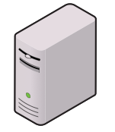

Mail gateways
Combination of hardware and software that
Filter spam/unsolicited mail
Prevent data loss (scan messages/filter keywords, attachments)
Handle encryption
Internet
DMZ
Internal Network
Internal
Mail
Server
Mail
Gateway
Firewall

Slide 3

Email filtering
Filter inbound mail
Stop spam/Unsolicited email advertisements
Control of phishing attempts
Anti-virus
Block bad attachments
Filter outbound mail (DLP – Data Loss Prevention)
Prohibit confidential information in emails
Scan for dubious behavior/keywords
Watch for sensitive information
Stop confidential attachments from going out

Slide 4

Identifying spam
Blacklist
List of common spam sources, reject mail from there
Whitelist
List of trusted sources of email, accept mail from those domains
Content/keyword filtering
Looks for phrases and wording in common spam messages
Reverse DNS
Rejects when sender’s domain doesn’t match the IP address
Tarpit/Delay-based filtering
Slow down the server conversation, some spammers can’t wait

Slide 5
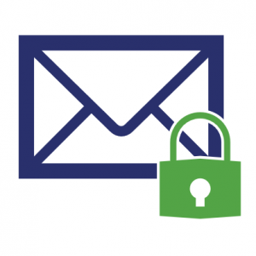
Email encryption
Mail is easily intercepted
Most mail is unencrypted
Send and receive sensitive information securely
Encryption techniques aren’t always seamless, cumbersome
Encryption can be forced at the gateway
Require encryption, sends password to the sender
Send alert message to the recipient telling them it’s a secure email
Modern email clients support encryption
Email gateway recognizes the encryption, handles the exchange

